Slide 1

Team Midjoiners
HDB Resale ETL Pipeline
Extract → EDA → Transform → Load → SQL Layer → Storytelling
Team Members [ JDE08 ]
Alvin - Extract & EDA Lead | Hon Boon - Transform Lead | Janson - Load Lead | Peisi - SQL Layer & Story Lead

Slide 2
Project Overview
What We Accomplished
A full ETL pipeline for the Singapore HDB resale dataset (2017 onwards):
• Extracted raw data from Data.gov.sg
• Performed EDA to understand quality and transformation needs
• Cleaned and enriched dataset
• Loaded structured data into PostgreSQL
• Built SQL views and analytical queries
• Presented insights through pure SQL storytelling
Notes:
Extract raw HDB resale data
Perform EDA
Transform dataset
Load into PostgreSQL
Run SQL checks
Build SQL views
Storytelling using SQL
Emphasise: SQL only project, no BI tools.

Slide 3
Why This Project Matters
• HDB resale market is highly dynamic
• Decisions involve price trends, lease decay, location and affordability
• Raw datasets are large and unstructured
• Good ETL can reveal insights not seen in apps like PropertyGuru
• Useful educational project for real world data engineering processes
Notes:
Singapore resale market is dynamic
ETL reveals insights
Supports data driven decisions
SQL only approach for clarity

Slide 4
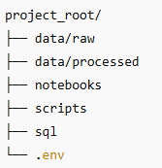
Project Folder Structure
Purpose:
• Clean separation of concerns
• Reusable scripts
• Clear pipeline flow
Notes:
data/raw
data/processed
notebooks/
scripts/
sql/
.env

Slide 5
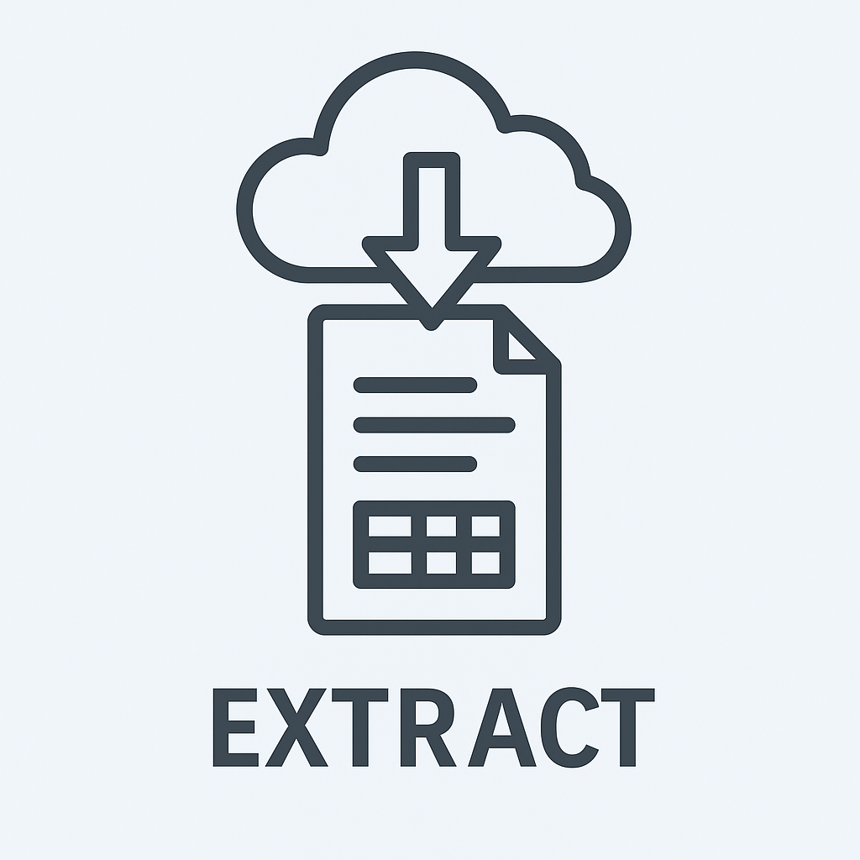
Phase 1: Extract
Key Points
• Used Data.gov.sg resale dataset
• Semi automated CSV retrieval
• Verified field consistency,
row count, schema
• Ensured reproducibility through notebook
Notes:
Semi automated extraction
Schema + row count checks
Reproducible steps

Slide 6

Phase 1: Exploratory Data Analysis
6 Key Findings
• No major missing core fields
• Remaining lease requires conversion
• Year, month, quarter derived fields needed
• Price trends rising sharply post 2020
• 4 Room flats dominate dataset
• Towns like Sengkang, Punggol, Tampines have highest volume
Notes:
Identify anomalies
Discover feature engineering needs
Confirm transformation rules
EDA informs Transform logic and SQL Layer requirements.

Slide 7
Phase 2: Transform
OBJECTIVE
The goal of the transformation is to clean, standardize, and enrich the dataset for analysis, visualization, and modeling purposes.
Raw Data Structure​
Column Name​ | Description​
_id​ | Unique identifier for each record​
month​ | Year-month of resale (YYYY-MM)​
town​ | Town/estate where the flat is located​
flat_type​ | Type of flat​
block​ | Block number​
street_name​ | Street name of the flat​
storey_range​ | Floor range of the flat​
floor_area_sqm​ | Floor area in square meters​
flat_model​ | Model of the flat​
lease_commence_date​ | Year the lease started​
remaining_lease​ | Remaining lease duration in years and months​
resale_price​ | Resale price​
Apply Cleaning Rule:​ 1.Check for any missing data​
2.Check for any duplicated data

Slide 8
Phase 2: Transform
Feature Engineering:​
1. Drop the ‘_id’ column​
2. Change the month to datetime type​
3. Create 3 new column, ‘month’, ‘year’ and ‘quarter’​
4. Get a new column ‘remaining_lease_years’​
5. Generate a new column ‘price_per_sqm’​
6 Generate a new column ‘flat_age_year’​
Derived Categories:
1. flat_age_category
new​ | <10 years​
young​ | 10-19 years​
middle age​ | 20-29 years​
mature​ | 30-39 years​
old​ | >39 years​
2. price_category
low​ | < 300k​
medium​ | 300k - 499k​
high​ | 500k - 799k​
premium​ | > 800k​

Slide 9
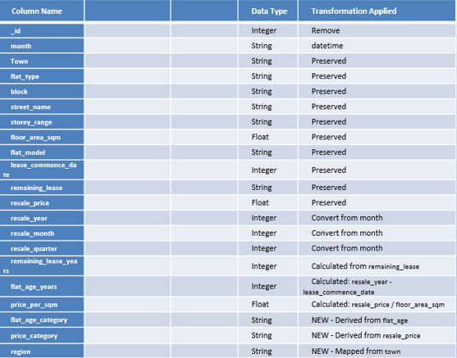
Phase 2: Transform
Output Data Schema
​

Slide 10

Phase 2: Transform
Create validation for the following:​
​
• floor_area_sqm​
• resale_price​
• lease_commence_Date
Output generated shows it is in a valid range

Slide 11
Phase 2: Transform
Challenges | Improvements
Regex library is a new item to learn | To add in gate to check the column name in case changes from input dataset
Using regex to do a search in string object to get the information needed | To standardize all the string input
Using the pathlib library to get the file and store the output file | To add in more detail validation to ensure all data is probably validated to prevent wrong data

Slide 12
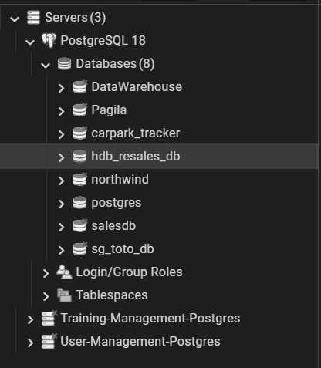
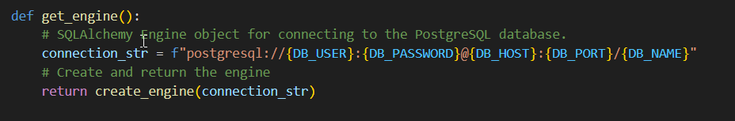
Phase 3: LOAD
OBJECTIVE: Move transformed data onto PostgreSQL for structured storage and analysis.
PostgreSQL Setup
Database created via pgAdmin or create_db.py | Connection handled by reuseable get_engine() function

Slide 13
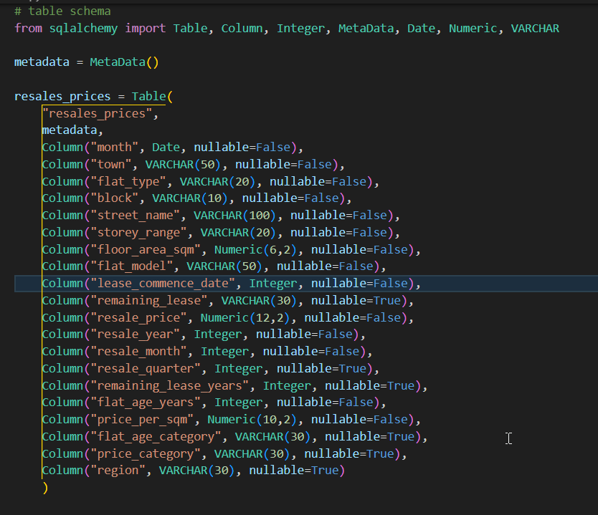
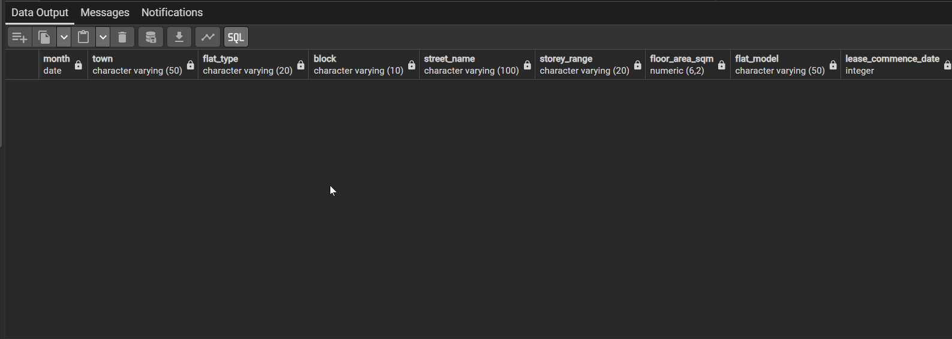
Phase 3: LOAD
Table Schema Definition | Create Table In PostgreSQL
Defined schema.py using SQLAlchemy | Table created via create_table.py

Slide 14
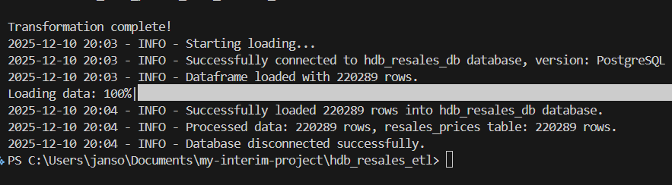
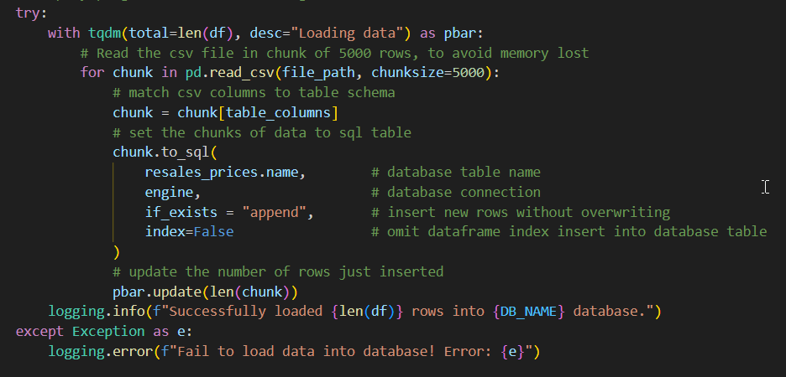
Phase 3: LOAD
Loading via Script
Data inserted using pandas.to_sql() with chunking (5000 rows)
Progress tracked with tqdm for visibility
Logging capture success / failure messages
Progress tracked
Logging
verification message
Chunking

Slide 15
Phase 3: LOAD
Challenges
File path handling
Issue: Confusion between relative path (../data/…) and absolute path (Path(__filer__)).
Fixed: Standardized on pathlib Path for consistent, cross-platform resolution.
Repeated code spread across multiple scripts
Issue: Code duplication across multiple scripts led to messy and hard to maintain code.
Solution: Refactored common logic (database connection) into a separate utility file. Import these functions, or configurations in each script to ensure consistency and reducing duplication.

Slide 16
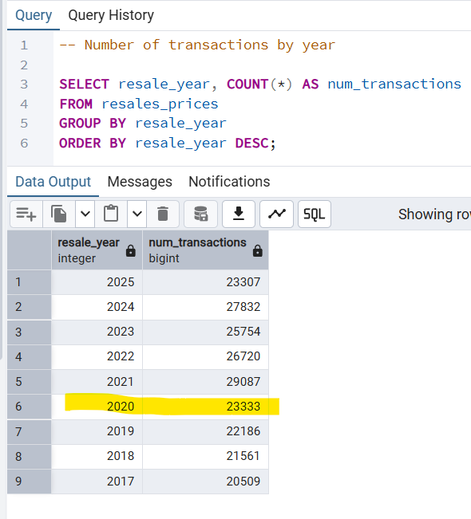
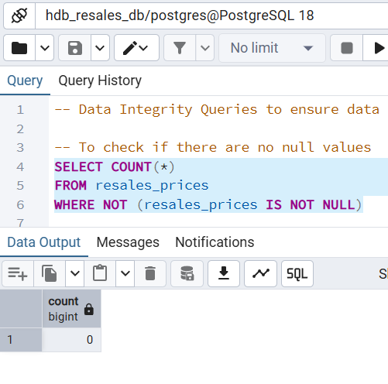
Phase 4: SQL Layer & Views
STEP 1 | Validate Data Integrity
STEP 2 | Reproduce EDA In SQL

Slide 17
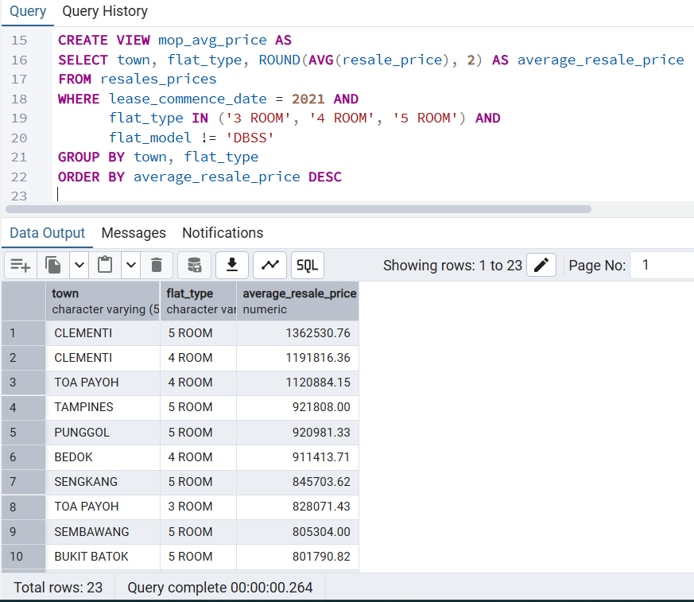
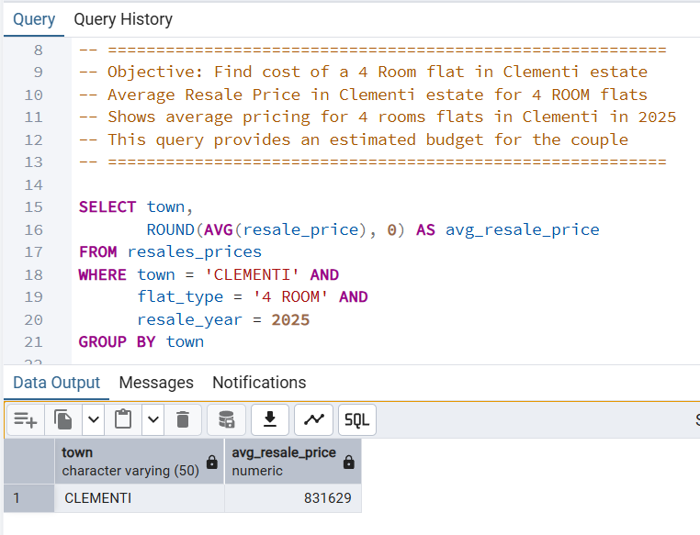
Phase 4: SQL Layer & Views
STEP 3 | Create Analytical Queries + Views
STEP 4 | SQL Queries Via Story

Slide 18

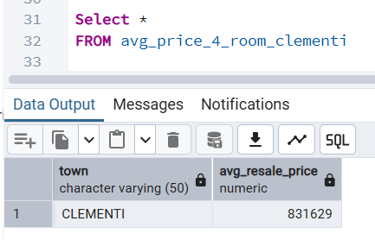
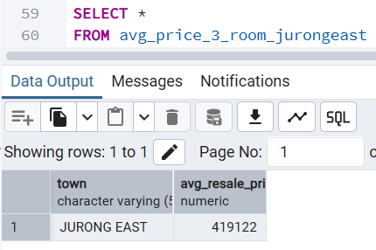
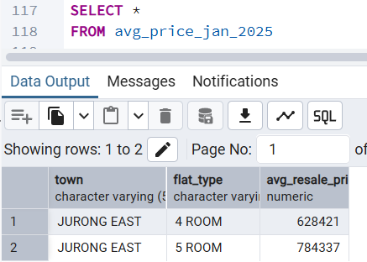
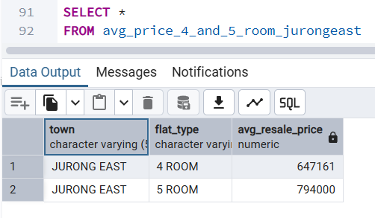
Phase 5: STORY IN SQL
Objective = Upgrade to
4 Room HDB flat
Current house = 3 Room HDB flat in Jurong East
Targeted location = Clementi (near good schools and NTU)
Estimated budget = $750k to $800k
Alternative location = Jurong East
1
2
Average Price
For 4 Room
Clementi
Average Price For 3 Room
Jurong East
VS
3
4/5 Room
Average Price
Jurong East
70 years left
Oct to Dec 2025
4
Average
Price from
Jan 2025

Slide 19
INSIGHTS & OBSERVATIONS
CHALLENGES | TAKEAWAYS
Attempted to add a visualisation tool ie Google Looker Studio but encountered a common error faced by users on forums, so had to abandon the idea due to constraint of time Tried Tableu but it is only free for public data otherwise, a fee is required | Clementi 4 Room flats are about 40% pricier than Jurong East 4 Room flats However prices in Jurong East could be comparable with Clementi when Jurong Lake District and MRT lines (JRL and CIL) are completed
The constraint of time led to working with 1 big data set instead of breaking it down into smaller groups ie normalisation | No of yearly transactions for 2025 have fallen by 16% since last year and is at the lowest volume since 2020 This shows the resale market is cooling off though prices have generally climbed throughout 2025

Slide 20
Phase 6: Future Improvements
Automation & Scheduling | ​Analytics Expansion | Scalable Data Model
Introduce Airflow or GitHub Actions | Build Power BI dashboards | Create star schema
Automated monthly refresh | Town trends & lease decay | Improve indexing & performance
Logging and alerting for ETL failures | Forecasting & anomaly detection | Prepare for new datasets
Notes:
Automate ETL
Add BI dashboard
Star schema
Forecasting

Slide 21

Key Takeaways & Closing
• Full ETL pipeline successfully implemented
• SQL views reveal insights clearly
• Transformations improve data clarity
• Storytelling shows real world usage
• Pipeline can scale with enhancements
THANK YOU
Notes:
Thank you
Questions?

